Slide 1
Intro to rmarkdown
NHS-R Conference 2021

Slide 2
Expectations
WORKSHOP PLAN
LUNCH BREAK
Background
Uses
Functionality
Parameterisation
YAML
Markdown
Code
rmarkdown Automation
Functionality Demo

Slide 3
Expectations
What is your current experience in R?
What is your current experience with Rmarkdown?
What do you want to take away from this workshop?
What tools do you use for your reporting?

Slide 4

What is rmarkdown?
Rmarkdown (and other packages) facilitate the development and production of highly versatile reports.
In simplest its simplest use rmarkdown can be seen as a type of code notebook where an analyst can create reproducible and accurate historical records.

Slide 5
Why Is This Useful?
The beauty of rmarkdown comes from the ability for an analyst to organise their code into an easy to read and reproducible report.
In our data world creating reproducible analyses is essential for continuity and accuracy.

Slide 6
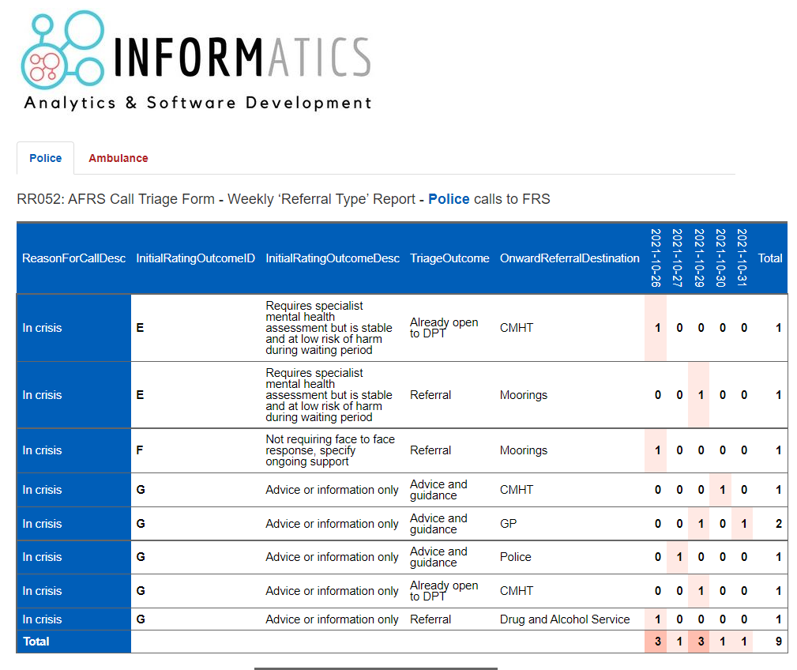
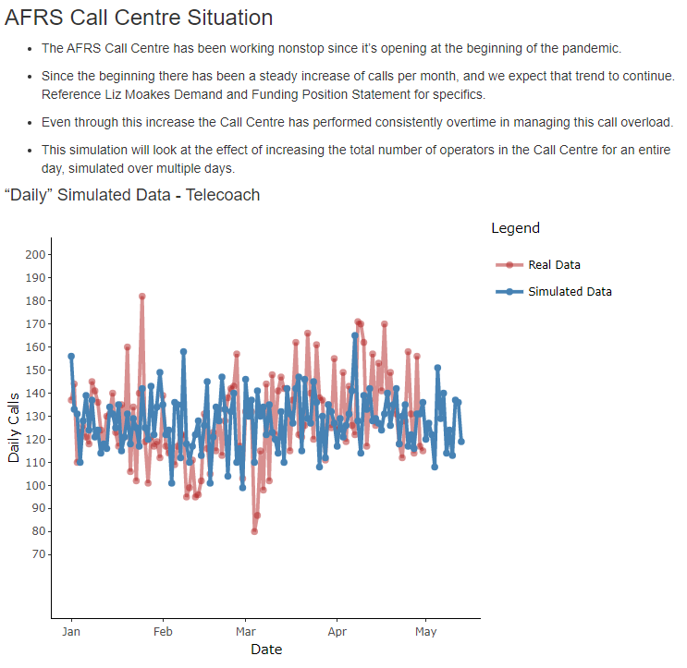
Examples

Slide 7
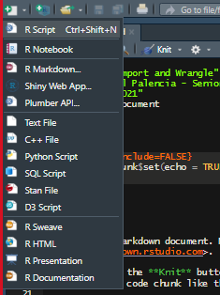
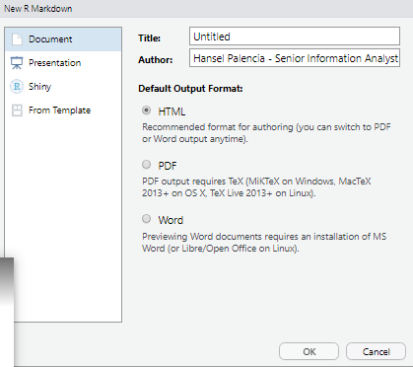
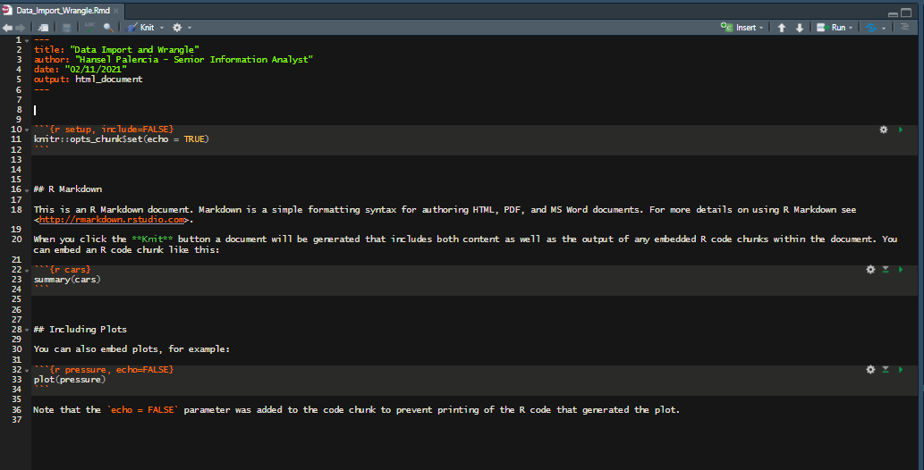
Creating a Report
Creating an rmarkdown (.rmd) file is easy!
Click the Paper with the green plus in the top left corner
Generate the type of file you want and click OK
DONE!

Slide 8
How does it work?
rmarkdown uses markdown language to generate its reports. It also supports a variety of other languages for data generation, manipulation, and visualisation.
rmarkdown essentially works in three main parts which we’ll look at shortly:
YAML – Creates and formats the specific type of report.
Markdown Area – Where text formatting and report outlines will go as well as some additional formatting.
Code area – “Chunks” where code goes that will run when the report is run.

Slide 9

YAML – Yet Another Markdown Language
The YAML is used to format the report as well as specify what type of output will be created.
Options include HTML, PDF, Word, Powerpoint, and more……

Slide 10
Markdown Area
The Markdown Area is used to format within the report itself.
Examples include: Headers, Tabs, Bolds, Italics, Lists, Numbered Lists, and more….

Slide 11

Code Area
The Coding Area is used as a space to develop code for the rmarkdown report.
The majority of times the final output of these code chunks will be some type of visualisation (graph, table, etc.)

Slide 12
SHOWCASE
Let’s See Your Efforts!

Slide 13

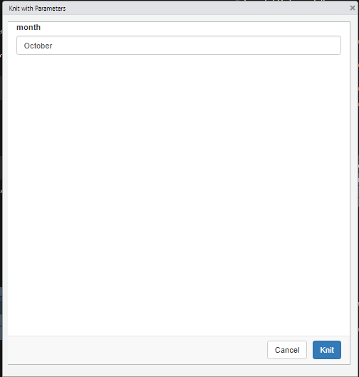
Paramaterised rmarkdown
Parameterised reports allow you to create multiple reports with different inputs (like working with functions)
The input parameter will take the location of every named parameter space

Slide 14
Functions for rmarkdown Automation
Since rmarkdown itself is a package there are some functions that can be used to generate reports on the fly.

Slide 15
Demo
There are a multitude of packages that can work in conjunction with rmarkdown, therefore allowing an analyst to create dynamic or interactive reports, giving a more dashboard feel.

Slide 16
Acknowledgements
NHS-R Community
Chris Beeley
Zoe Turner
Mohammed Mohammed

